Slide 1
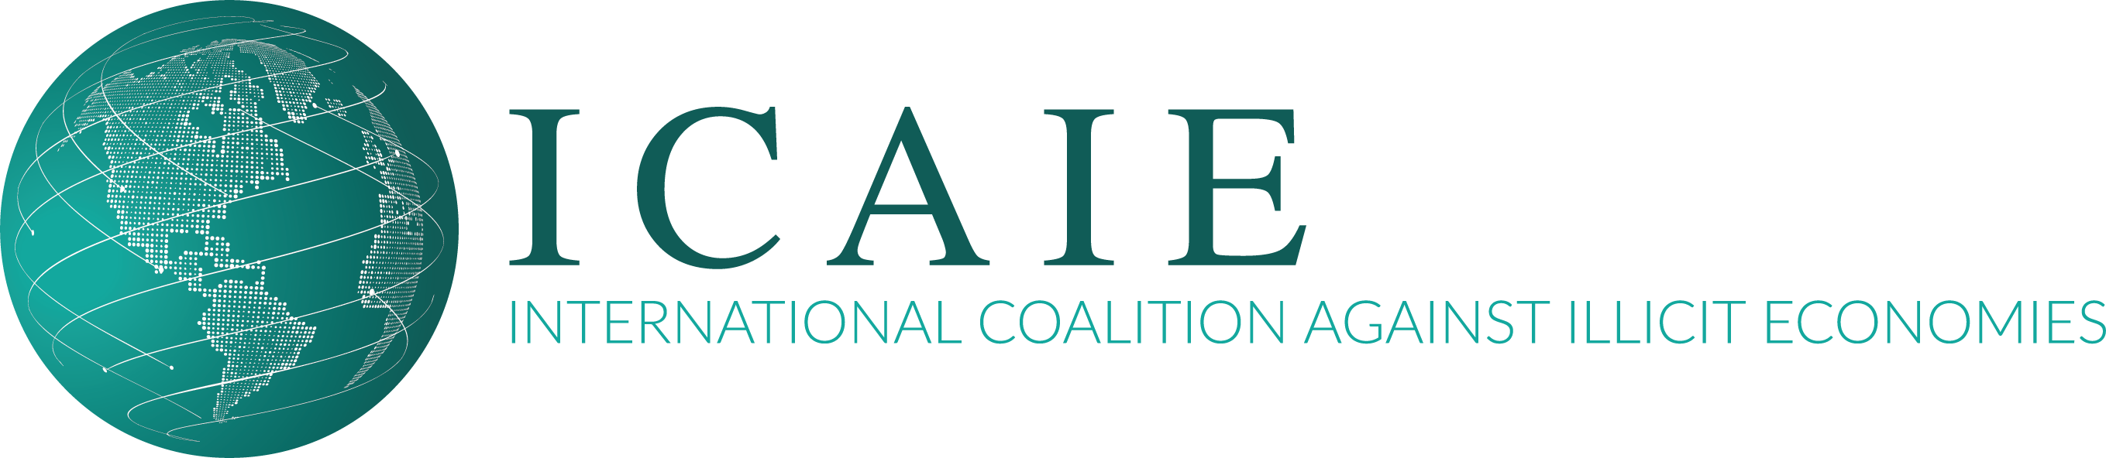
Emerging Transnational Organized Crime Threats in Latin America
Douglas Farah, IBI Consultants
Senior ICAIE Adviser
USSOUTHCOM June 2023
David M. Luna, ICAIE, Executive Director

Slide 2
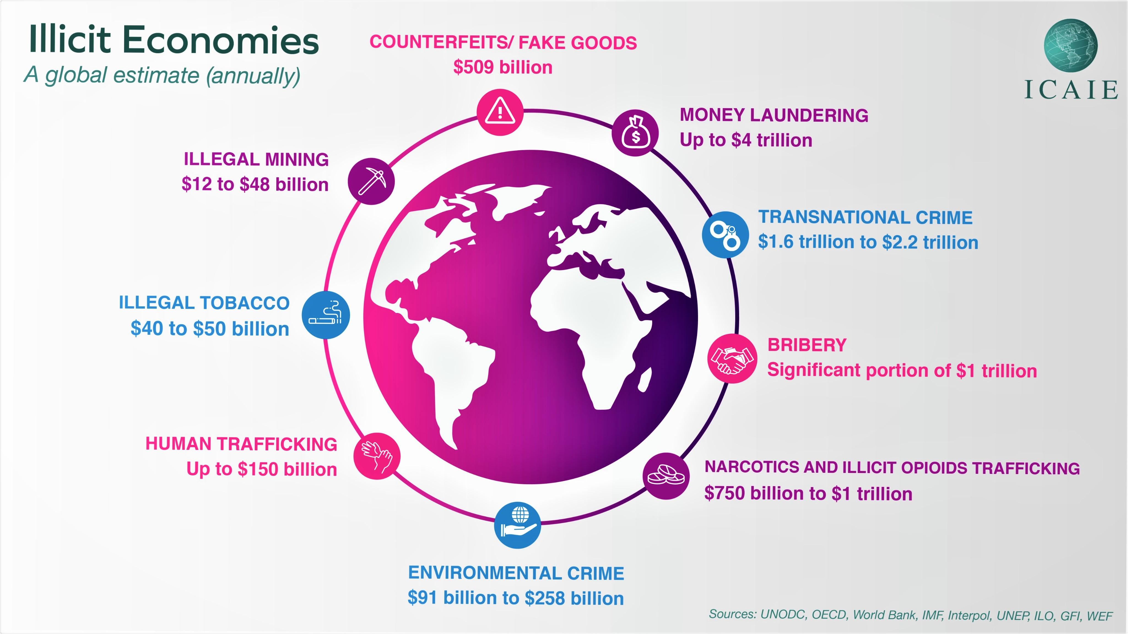
Crime Convergence

Slide 3


GORDIAN BLUEPRINT
Solving the perceived demonically difficult
Member initiated
Coalition resourced
Demonstrated capability
Threat Intelligence
Corruption and Money Laundering/TBML/Terrorist Financing
CTOC/Crime Convergence/Cross-Border Smuggling and Trafficking Crimes
Illicit Economies
Identifying Synaptic Nodes/Bad Actors/Threat Neural Networks
Great Power Competition

Slide 4
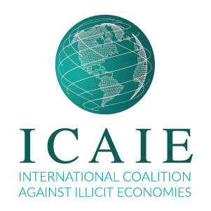
Countering “Illicit Spaces” Across Threat Landscapes
Regulatory Transparency /
Governance Gaps
Impacts of Converging
OC Threats in Illicit Spaces
Illicit Trade/Illicit Economies
Monitor regulatory/governance gaps and lax oversight; dissuade counterfeiting, criminal practices, and; disrupt illegal trade, smuggling, and trafficking across FTZs.
Understanding harmful effects of illicit economies; collecting evidence of illicit trade; information-sharing across sectors; conduct joint and cross-border investigations and support calls for prosecution.
Countering Fakes:
Regulatory/
Governance Gaps
6
Money Laundering/TBML
5
Shutting Down Money Laundering Vulnerabilities
AnonymitySurfacing Bad Actors
Anonymous Shell Companies
End the abuse of anonymous shell companies, in which kleptocrats, criminals, and terrorists have avoided detection. laundered dirty money, and financed other threats, operations, and illicit industries.
Identify ML/Threat Finance systemic weaknesses and vulnerabilities; invest in capabilities for detecting trade-based money laundering (TBML).
4
Bribery/Corruption
3
Threat Intelligence
Technologies
Make Corruption/Bribery a Priority
2
The reality is that both corruption and organized crime are threat multipliers across illicit spaces that ripple across borders and imperil democratic transparency and institutions and systems vital for open, free, and just markets/societies.
Threat Intelligence/Enforcement
1
Invest in Anti-Illicit Trade Prevention,
Risk Management, and Enforcement Strategies, Full Spectrum Solutions and Technologies.

Slide 5
Overview: Rapidly Transforming Hemispheric Threat Environment
New actors, new markets and new products are driving fragmentation among traditional groups, consolidation of criminalized economies
Rise of ideologically agnostic criminalized states opens new opportunities and alliances across the hemisphere
Consolidation of multi-product rather than mono-product (cocaine) networks and convergence centers
Traditional criminal actors based in Colombia and Mexico are now competing with – and sometimes collaborating with – new actors such as transnational gangs in Brazil and Central America, as well extra-regional, non-traditional actors.
New presence of Albanian organized crime, Turkish criminal groups, Libyan actors and Italian mafia groups
The Mexican Cartel Jalisco Nueva Generación (CJNG) has displaced the Sinaloa cartel as the dominant criminal network, expanding its illicit pipelines from primarily trafficking in cocaine to dominating fentanyl markets, fake pharmaceuticals, precursor chemicals methamphetamines and a host of other products.
The malign influence of China, Russia, and Iran exacerbates regional anti-crime strategies.
Result: New revenue opportunities, new learning opportunities, new threats, new criminal convergence centers

Slide 6
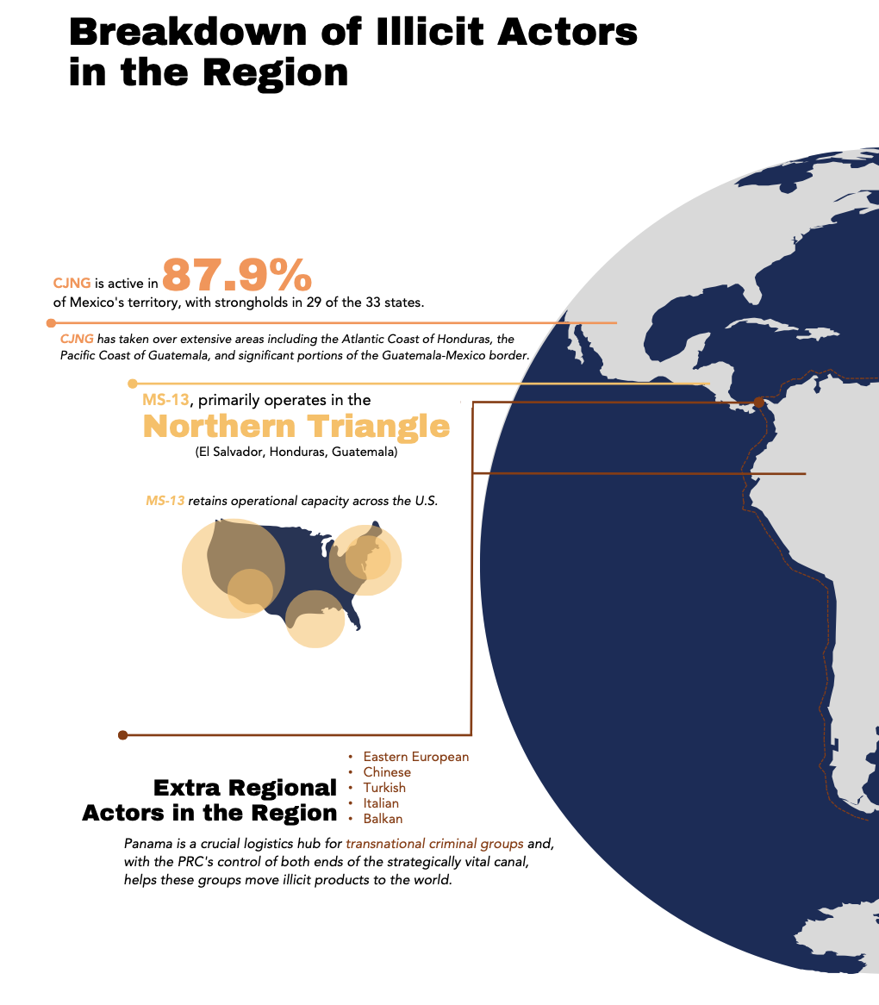
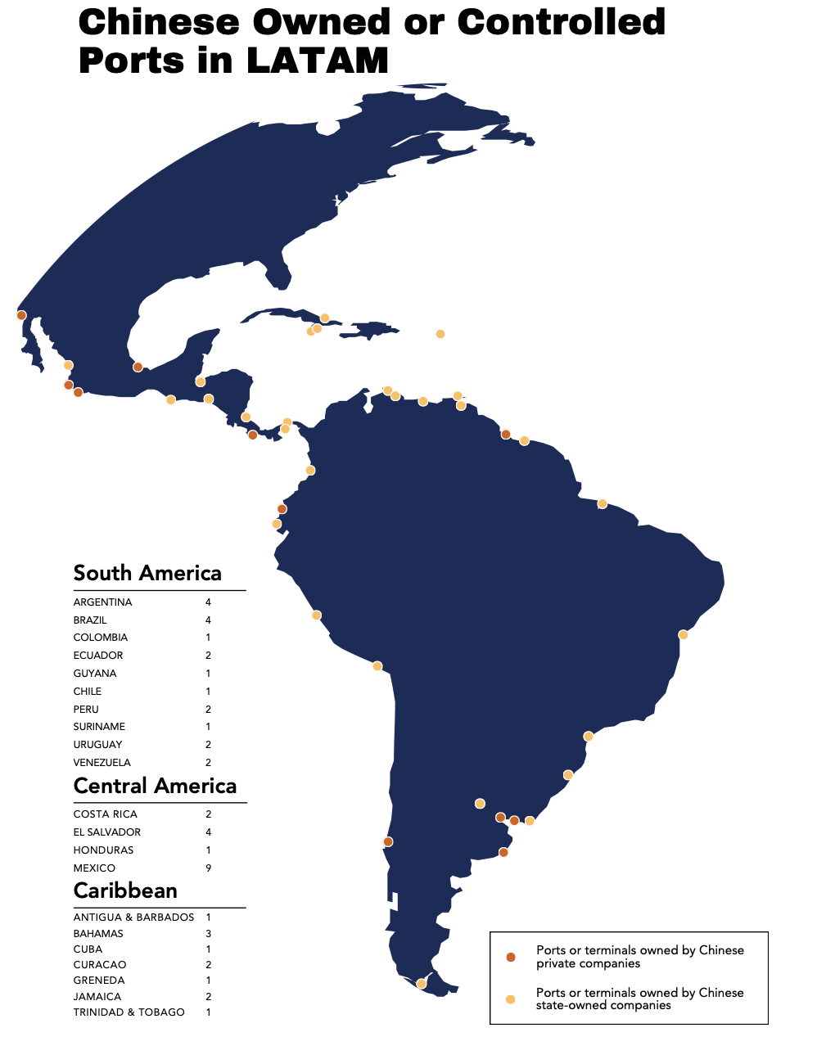

Slide 7
Trafficking in Natural Resources
Illicit natural resource trafficking opens new revenue streams for transnational criminal organizations. The trade contributes to massive environmental degradation, health hazards, child labor, human trafficking and loss of state legitimacy
Point of convergence for multiple traditional and new illicit networks (ex-FARC, Sinaloa, CJNG, UAE, Libya, Turkey, Nicaragua)
Illegally mined gold is an unregulated trade booming across the hemisphere from Venezuela, Colombia, Ecuador, Guyana, and in the north to the Madre de Dios regions of Peru and Bolivia and the Amazon Basin in Brazil
Illicit gold mining provides fungible assets that are easy to transport, largely impossible to trace once extracted, and readily convertible in markets around the world
If gold is at 95 percent purity or below while transported, it does not legally have to be declared a financial instrument. This makes it easy to move nearly pure gold to a financial hub without declaring it, refine it in situ and have gold that can be turned into cash immediately in ways that avoid the formal banking system
Transnational criminal organizations develop pipelines to move gold to market, and ultimately also use these pipelines to traffic other natural resources such as coltan, timber, and exotic endangered animal species.

Slide 8

The Ascent, Diversification, and Expansion of the CJNG
CJNG has emerged as the most prominent cocaine trafficking organization in Latin America, expanding its territorial control in multiple jurisdictions in order to control all illicit activities rather than just cocaine.
CJNG rapidly scaled up its business opportunities inside and outside of Mexico, while moving to diversify its portfolio and develop new methodologies for laundering and moving its illicit proceeds.
The CJNG’s rise has included political assassinations on powerful figures in the Mexican Department of Defense, including Coronel Hector Miguel Vargas Carrillo, who was killed in a criminal ambush on January 21, 2023
The CJNG bolstered its influence into territorial and economic supremacy that has facilitated business expansions into new criminal economies. These expansions take advantage of transnational networks, in particular networks in Oceania and Asia, exploiting regulatory gaps and incomplete law enforcement capabilities
A primary area of the CJNG’s expanded and diversified economic profile now includes a growing dominance in the trafficking of fake medicines and counterfeit pharmaceuticals (multi billion dollar)
Fake medicine has included treatments for HIV, cancer, osteoporosis, diabetes, blood pressure, cholesterol, and obesity. Counterfeit pharmaceuticals are often sold for a fifth of the price of real medicine. Pharmacists who oppose the sale of the counterfeit medicines do so at risk to their own lives.
The CJNG and other cartels’ trafficking of counterfeit medicine includes increased production and trafficking of synthetic opioids, produced using Chinese suppliers

Slide 9
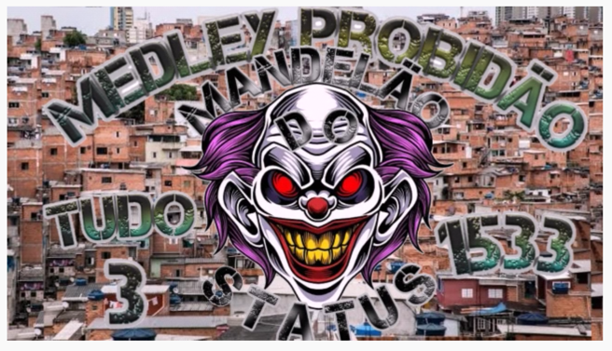
Beyond Gangs: The MS-13 and PCC as Important TCOs
The MS-13 (Mara Salvatrucha) in Central America and the PCC (Primeiro Comando da Capital) in Brazil have been formerly identified primarily as street thugs known for their ruthless violence, flashy tattoos, neighborhood extortion rings and cultural insularity
These groups have moved beyond neighborhood gangs to Community Embedded Transnational Armed Groups (CETAGs) in informal and imperfect alliances. As such, they pose enormous and little-understood challenges to U.S. strategic interests
The groups – no longer gangs but transnational criminal structures – are becoming more deeply enmeshed in the global drug trade, illicit economies and armed conflicts in the hemisphere
Both groups rely on a hierarchical structure that is simultaneously rigid and allows for local autonomy. At the highest levels, the hierarchies are pyramid shaped. Leaders achieve coordination through bodies known as sintonias (PCC) and ranflas (MS-13), but local groups have significant freedom in implementing decisions they receive from upper leadership.
Local, retail drug sales (narco menudeo) create local demand and provide income that allows them to diversify their criminal portfolios and move away from deeply unpopular revenue streams such as extortion in the neighborhoods they control.
While the PCC, unlike the MS-13, does not have operational U.S. branches and does not operate near a U.S. border, this CETAG has a demonstrated capacity to disrupt and destabilize multiple countries in the hemisphere – most notably Paraguay and Bolivia – as well as the operational capacity to deliver cocaine and other illicit products to Brazil, Africa and Europe.

Slide 10
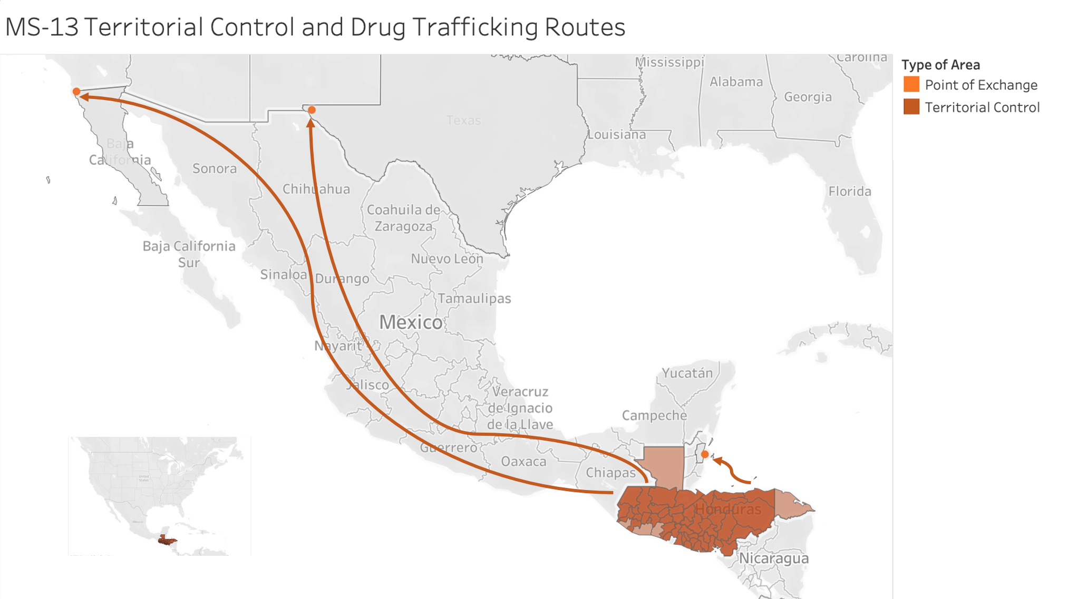
MS-13 EVOLUTION: Divergent Paths to Power

Slide 11
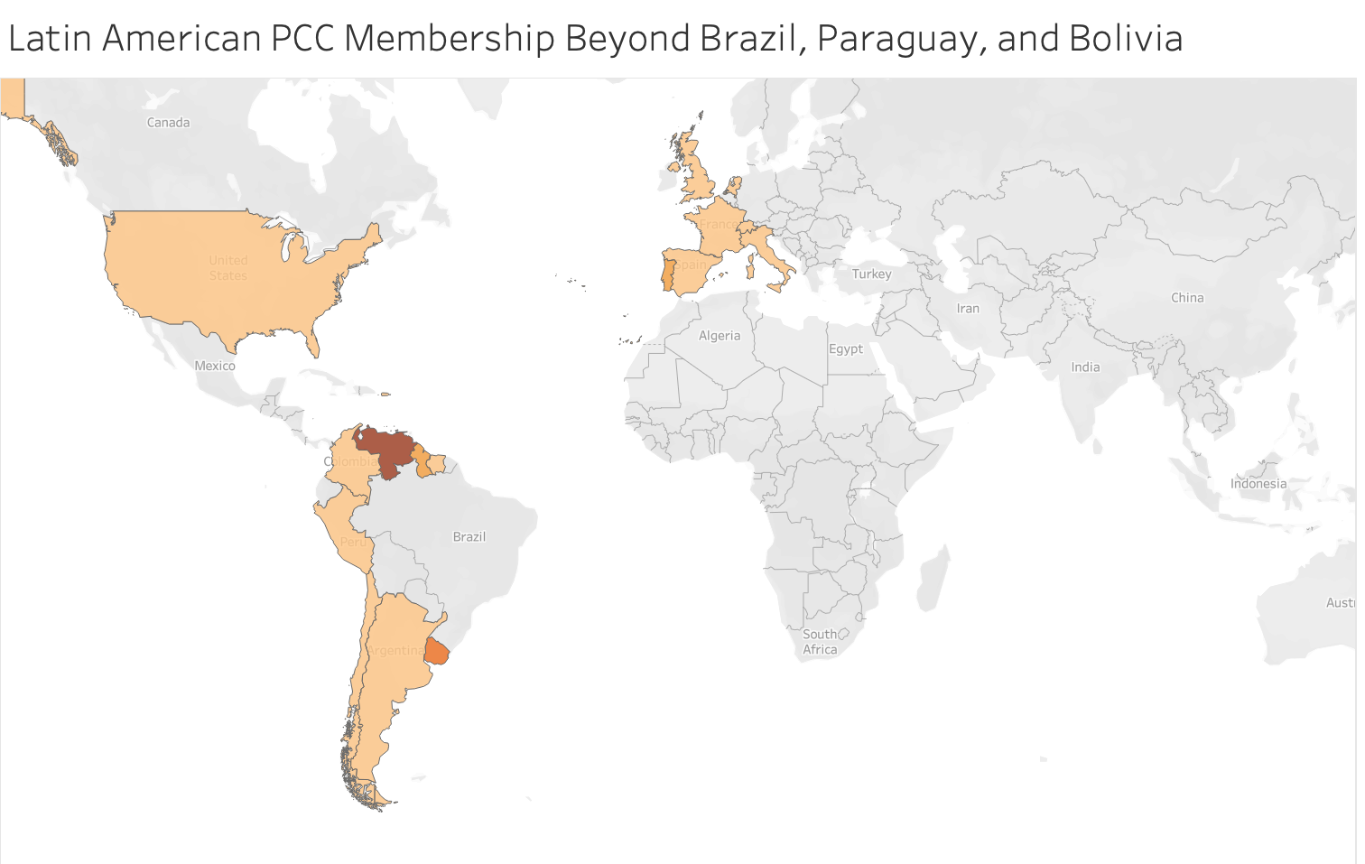

Slide 12
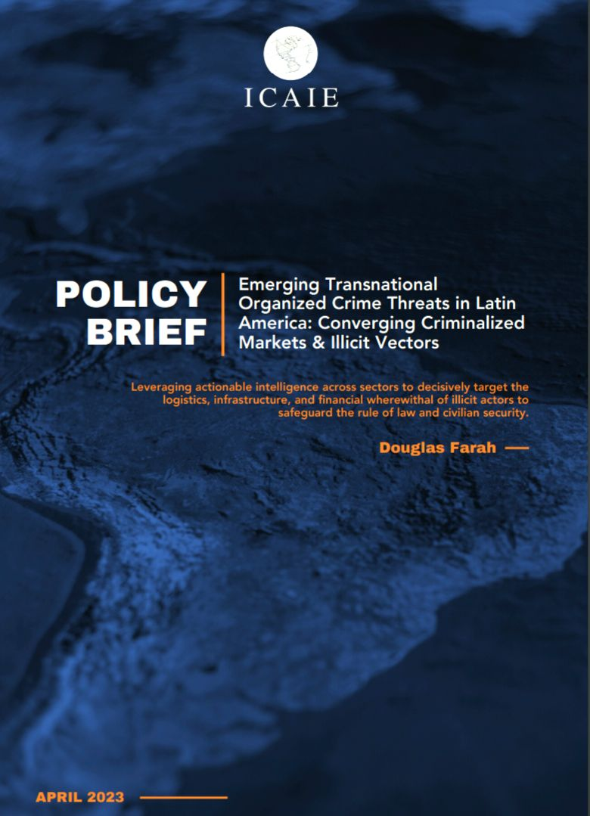
The Emergence of New Extra-Regional Criminal Structures
Now, operating along side––and sometimes in competition with––the fragmenting and realigning regional structures, there is a growing presence of Eastern European, Chinese, Turkish, Italian and Balkan syndicates vying for space
One of the most notable cases involved the seizure of 20 tons of cocaine – the largest of its type ever – from the MSC Gayane cargo ship in the port of Philadelphia on June 17, 2019 with Albanian, Kosovar and Greek criminal groups are competing alongside Mexican cartels for power in Ecuador
Albanian and Kosovar nationals identified as criminal leaders in Ecuador and rising prison violence. The Ecuadoran media reports that at least six murders of Albanians since 2019. Some characteristics of these murders make them appear as uniquely Albanian acts. Ex: murders outside a person’s home
Turkish organized crime has been developing inroads into Venezuela since at least 2020. Tell-all videos from exiled Turkish crime boss Sedat Peker allege various criminal relationships between Turkish groups and senior Turkish government officials taking place in Venezuela
In November 2022, authorities arrested 49 people in Dubai, Spain, France, Belgium, and the Netherlands, all with alleged ties to the so-called 'Super Cartel’ whose operations routed through Panama
Key fixer networks for gold, oil sales in UAE, Libya, Turkey to support ideologically agnostic regimes.

Slide 13
Ideologically Agnostic Criminalized States
The growing, ideologically agnostic criminalized authoritarian model has opened new possibilities for formerly antagonistic groups to undertake lucrative joint ventures.
One-time ideological opponents are no longer considered enemies, but potential business partners who can provide or purchase specific criminal services and profit handsomely in the process
Few states are wholly criminalized and most operate along a continuum. At one end are strong criminalized states, where the state acts as a partner of TCOs and/or use TCOs as an instrument of state policy.
In addition to Venezuela, Nicaragua, Bolivia and Cuba of the Bolivarian bloc these include the countries of the Northern Triangle of Central America (El Salvador, Honduras, Guatemala); and possibly Paraguay
Such systemic corruption, coupled with waning U.S. influence, has opened the door for hostile extra-regional actors such as Russia, China and Iran to gain significant footholds in the hemisphere

Slide 14
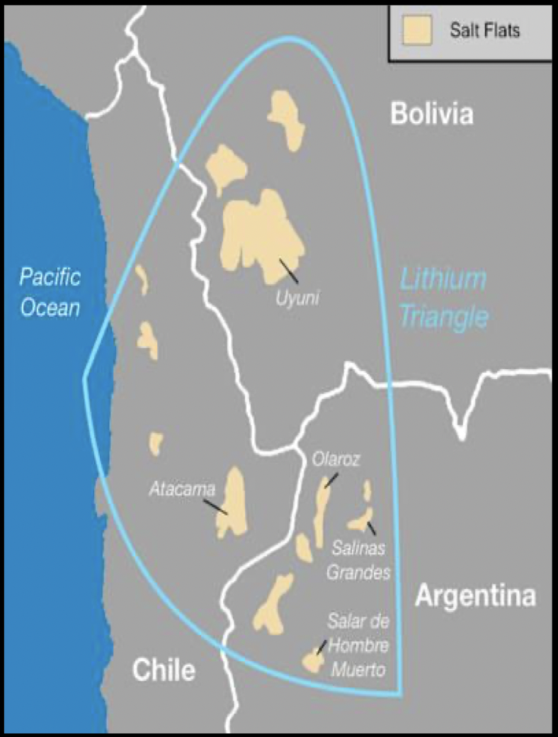
Convergence Case Study: Argentina’s Opaque PRC Lithium Extraction
While China has made inroads in most countries in the hemisphere, no country shows this dramatic historical reversal in alliances in Great Power strategic competition than Argentina :
  Deep Space Station
  Ushuaia Port (Antarctic)
  Nuclear projects
  Weapon sales
Argentina, along with Bolivia and Chile, form the lithium triangle with an estimated 55 percent of the world’s reserves. Of the three countries,
Almost all lithium deposits are under the control of feudal, criminalized, autonomous provincial governors with ties to PRC: part of the Kirchner machine, not National government
Near-total autonomy at the local level provides China with opportunities to arrange deals with no accountability, no transparency, no environmental impact remediation, and no way to monitor if the traditional corruption practices are in play
Located in increasingly important cocaine highway from Peru/Bolivia that enforces regional criminal structures
The value of Argentina’s lithium exports jumped from $206 million in 2021 to $696 million in 2022 and expected to at least triple in the next five years, making it one of the country’s fastest growing economic sectors and one where tight control over the extraction becomes ever more valuable.
PRC has clear advantage in very uneven playing field for vital strategic mineral

Slide 15

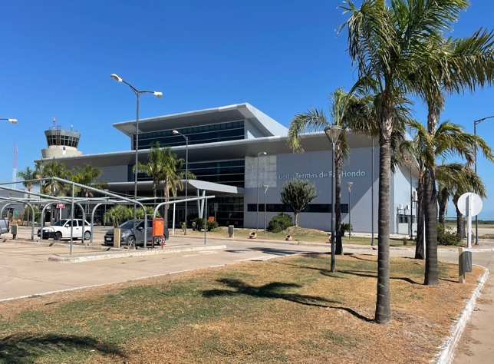
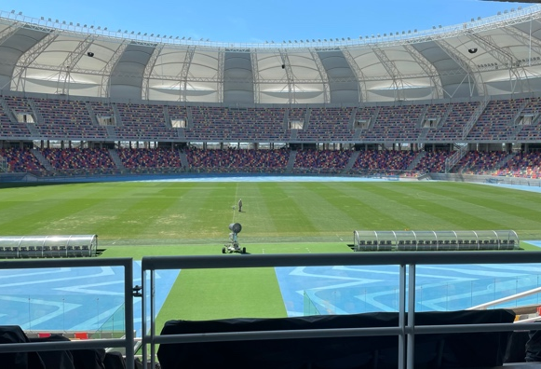
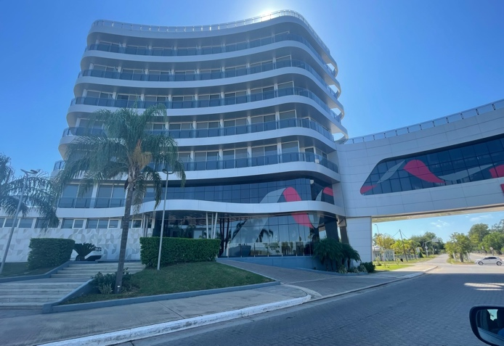
Case Study: Santiago del Estero, House of Mirrors
Governor Gerardo Zamora and wife Claudia Ledesma in power since 2005
Key Kirchner ally and vote deliverer and close ties to PRC
Province sits on Rte. 34, primary cocaine highway from Peru/Bolivia to Atlantic ports – possible source of inexplicable revenues
History of economically irrational, multi billion-dollar mega projects in poorest province with little revenue and deep corruption (airport with no flights, mega stadium with no games, auto racing course with no races etc.)
Private intelligence equipment, private police, private justice
Opaque and irrational deal with PRC to manufacture ion lithium batteries despite lack of infrastructure to fulfill promise
”Consortium for Cooperation for the Manufacture of Ion Lithium Cells and Batteries” formed with three Chinese companies and no bidding process

Slide 16
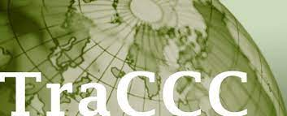
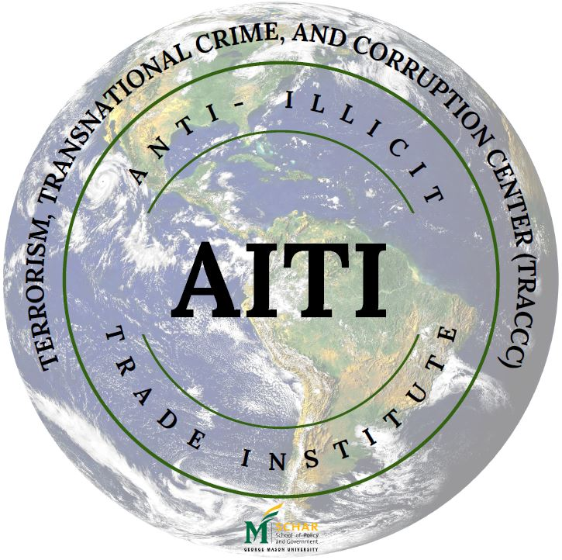
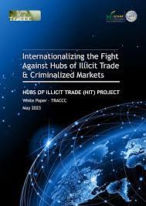
Hubs of Illicit Trade Project
The Hubs of Illicit Trades project is a strategic evidence-based research initiative that was launched in June 2022 by the Anti-Illicit Trade Institute (AITI) and the Terrorism, Transnational Crime and Corruption Center (TraCCC).
Its key objective is to inform policymakers and communities on the inter-connected harms and multiple and compounding threats associated with key hubs of illicit trade.
Its coverage includes various types of illicit trades, including the smuggling and trafficking of narcotics, weapons, humans, counterfeit and pirated goods, illegal tobacco and alcohol products, gold and precious minerals.
Its geographical focus lies on four well-known hubs of illicit trade:
Tri-Border Area (TBA)/South America,
Dubai,
Central America, and
Ukraine/Eastern Europe.

Slide 17
Conclusion & Recommendations
New groups, new markets, and new tactics are undermining regional state sovereignty and U.S. hemispheric interests
Changes are opening new opportunities for malign actors from other parts of the world such as criminal groups from Albania, Turkey, and Greece, as well as illicit trade networks in Asia and Chinese companies with ties to PRC government interests.
Transnational criminal groups such as the MS-13 and the PCC that were formerly local or regional in nature have transformed into significant international stakeholders and threats
The CJNG is operating at an increased level of sophistication and supremacy, requiring even more extensive government coordination in order to meaningfully counteract its advances
Ideologically agnostic authoritarian regimes open possibility of forming illicit networks and convergence centers outside traditional bounderies, with goal of keeping power.

Slide 18

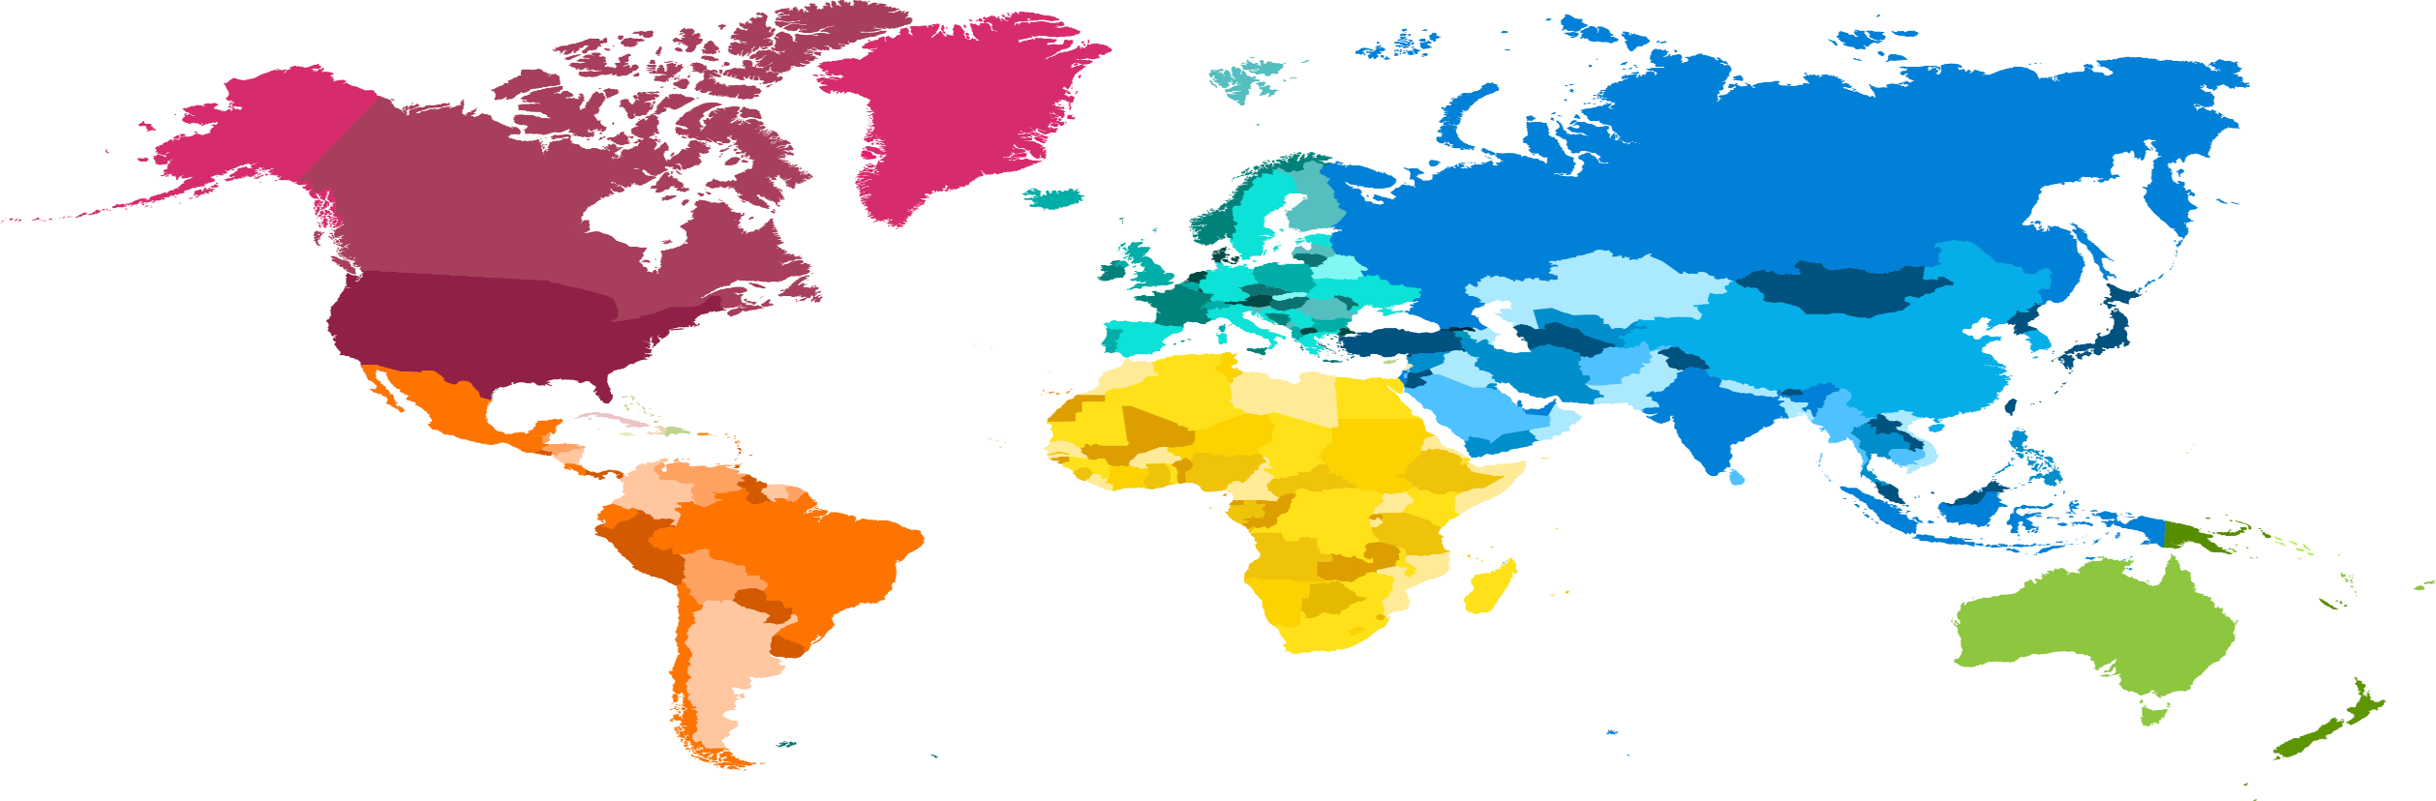
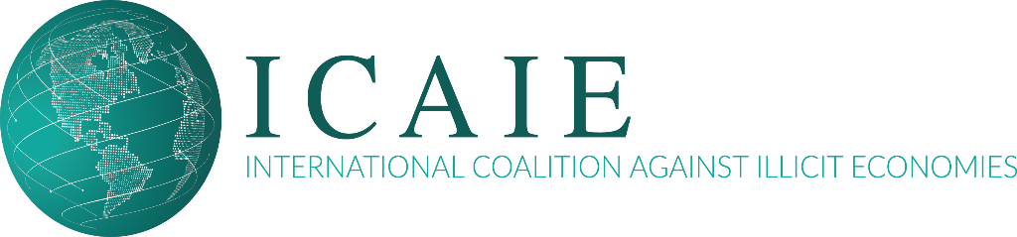
Bring Us Your Problem Sets: Let's Find Solutions to counter illicit trade / organized crime and corruption / threat finance:
https://www.icaie.com/

