Slide 1
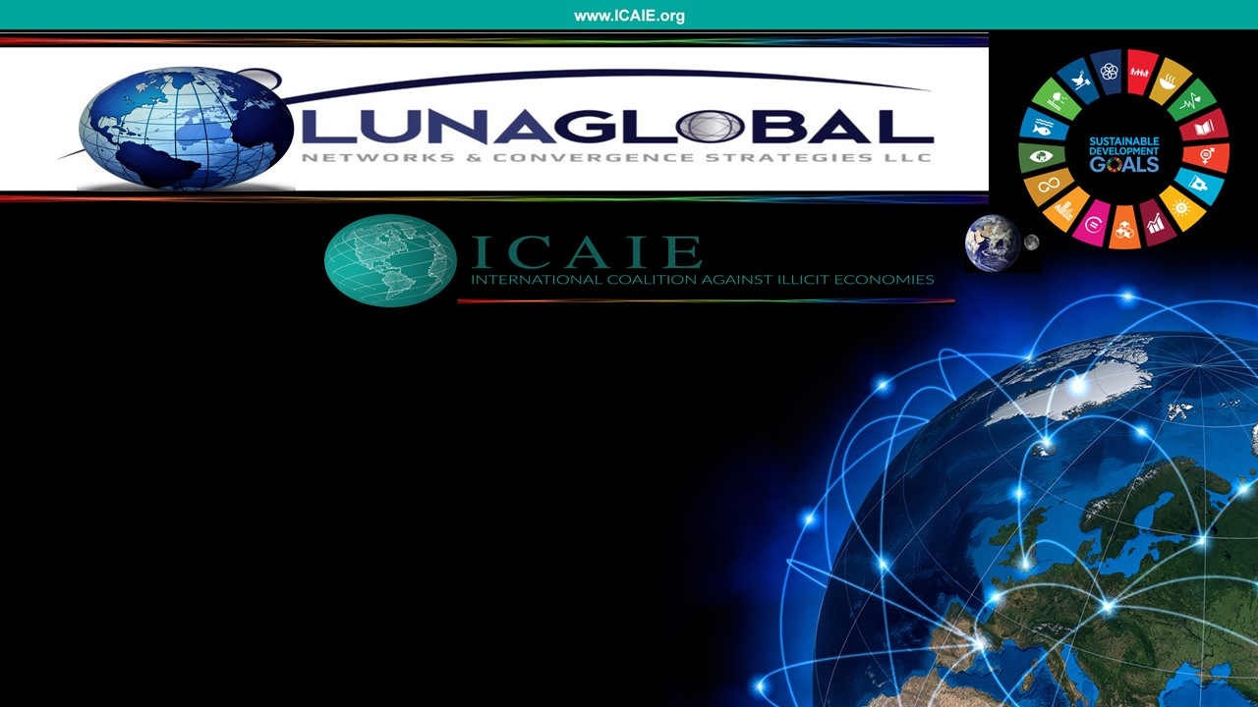
COUNTERING RISKY & UNRULY ILLICIT SPACES ACROSS FTZs
WFZO-INTA Dialogue
Free Trade Zones (FTZs):
How to Combat Illicit Trade & Counterfeiting
David M. Luna
President & CEO, Luna Global Networks
Executive Director, ICAIE
8 September 2021

Slide 2
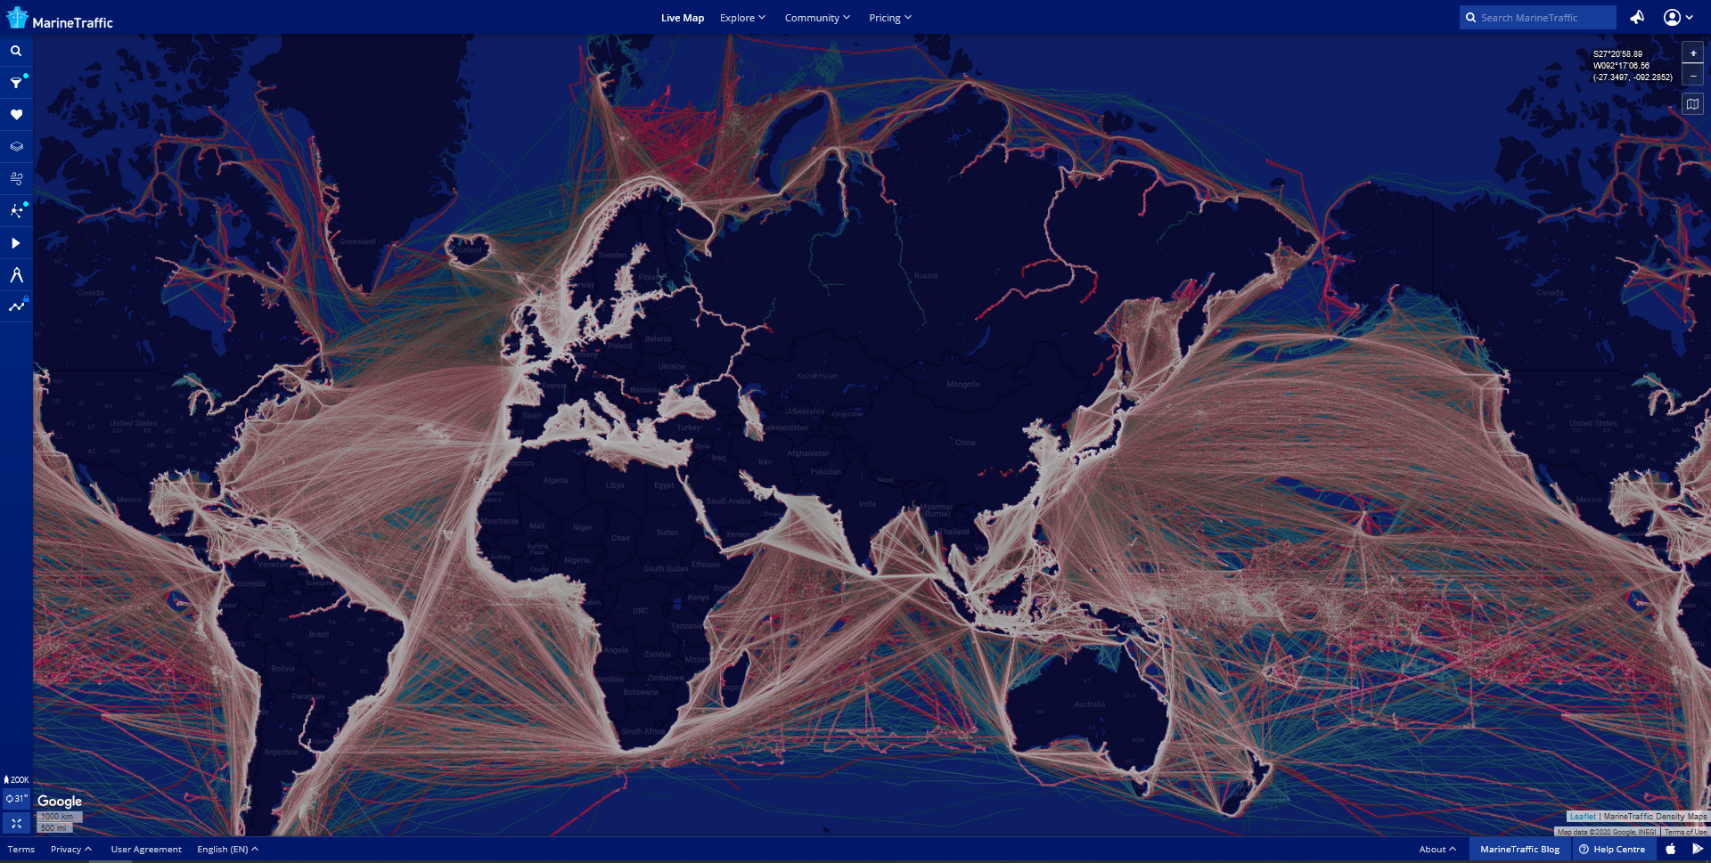
Free Trade Zones can have a catalytic effect on economies, including attracting Foreign Direct Investment and helping to expand economic development, growth and prosperity.
Note: nearly 63% of customs seizures of counterfeit and pirated goods involve small parcels; US: 90 percent; BUT in terms of value: 80% shipping.
In 2019, the global trade value of goods exported throughout the world amounted to approximately 19 trillion U.S. dollars at current prices.
About 90% of all trade is conducted via maritime containers
of which more than 500 million are shipped yearly in the trade supply chain, less than 2% are inspected;
25 % of such trade goes through FTZs.
TRUST and Info-sharing Cooperation across Ports/FTZs, etc.
But in too many parts of the world, FTZs are also exploited on a daily basis by some to facilitate illicit activities that produce broader market reputational harm and put the economic and physical security of many communities in danger.
MarineTraffic Density Maps for 2018 and 2019 provides snapshot of the most-travelled sea routes around the globe. https://www.marinetraffic.com/blog/shipping-trends-at-a-glance/

Slide 3
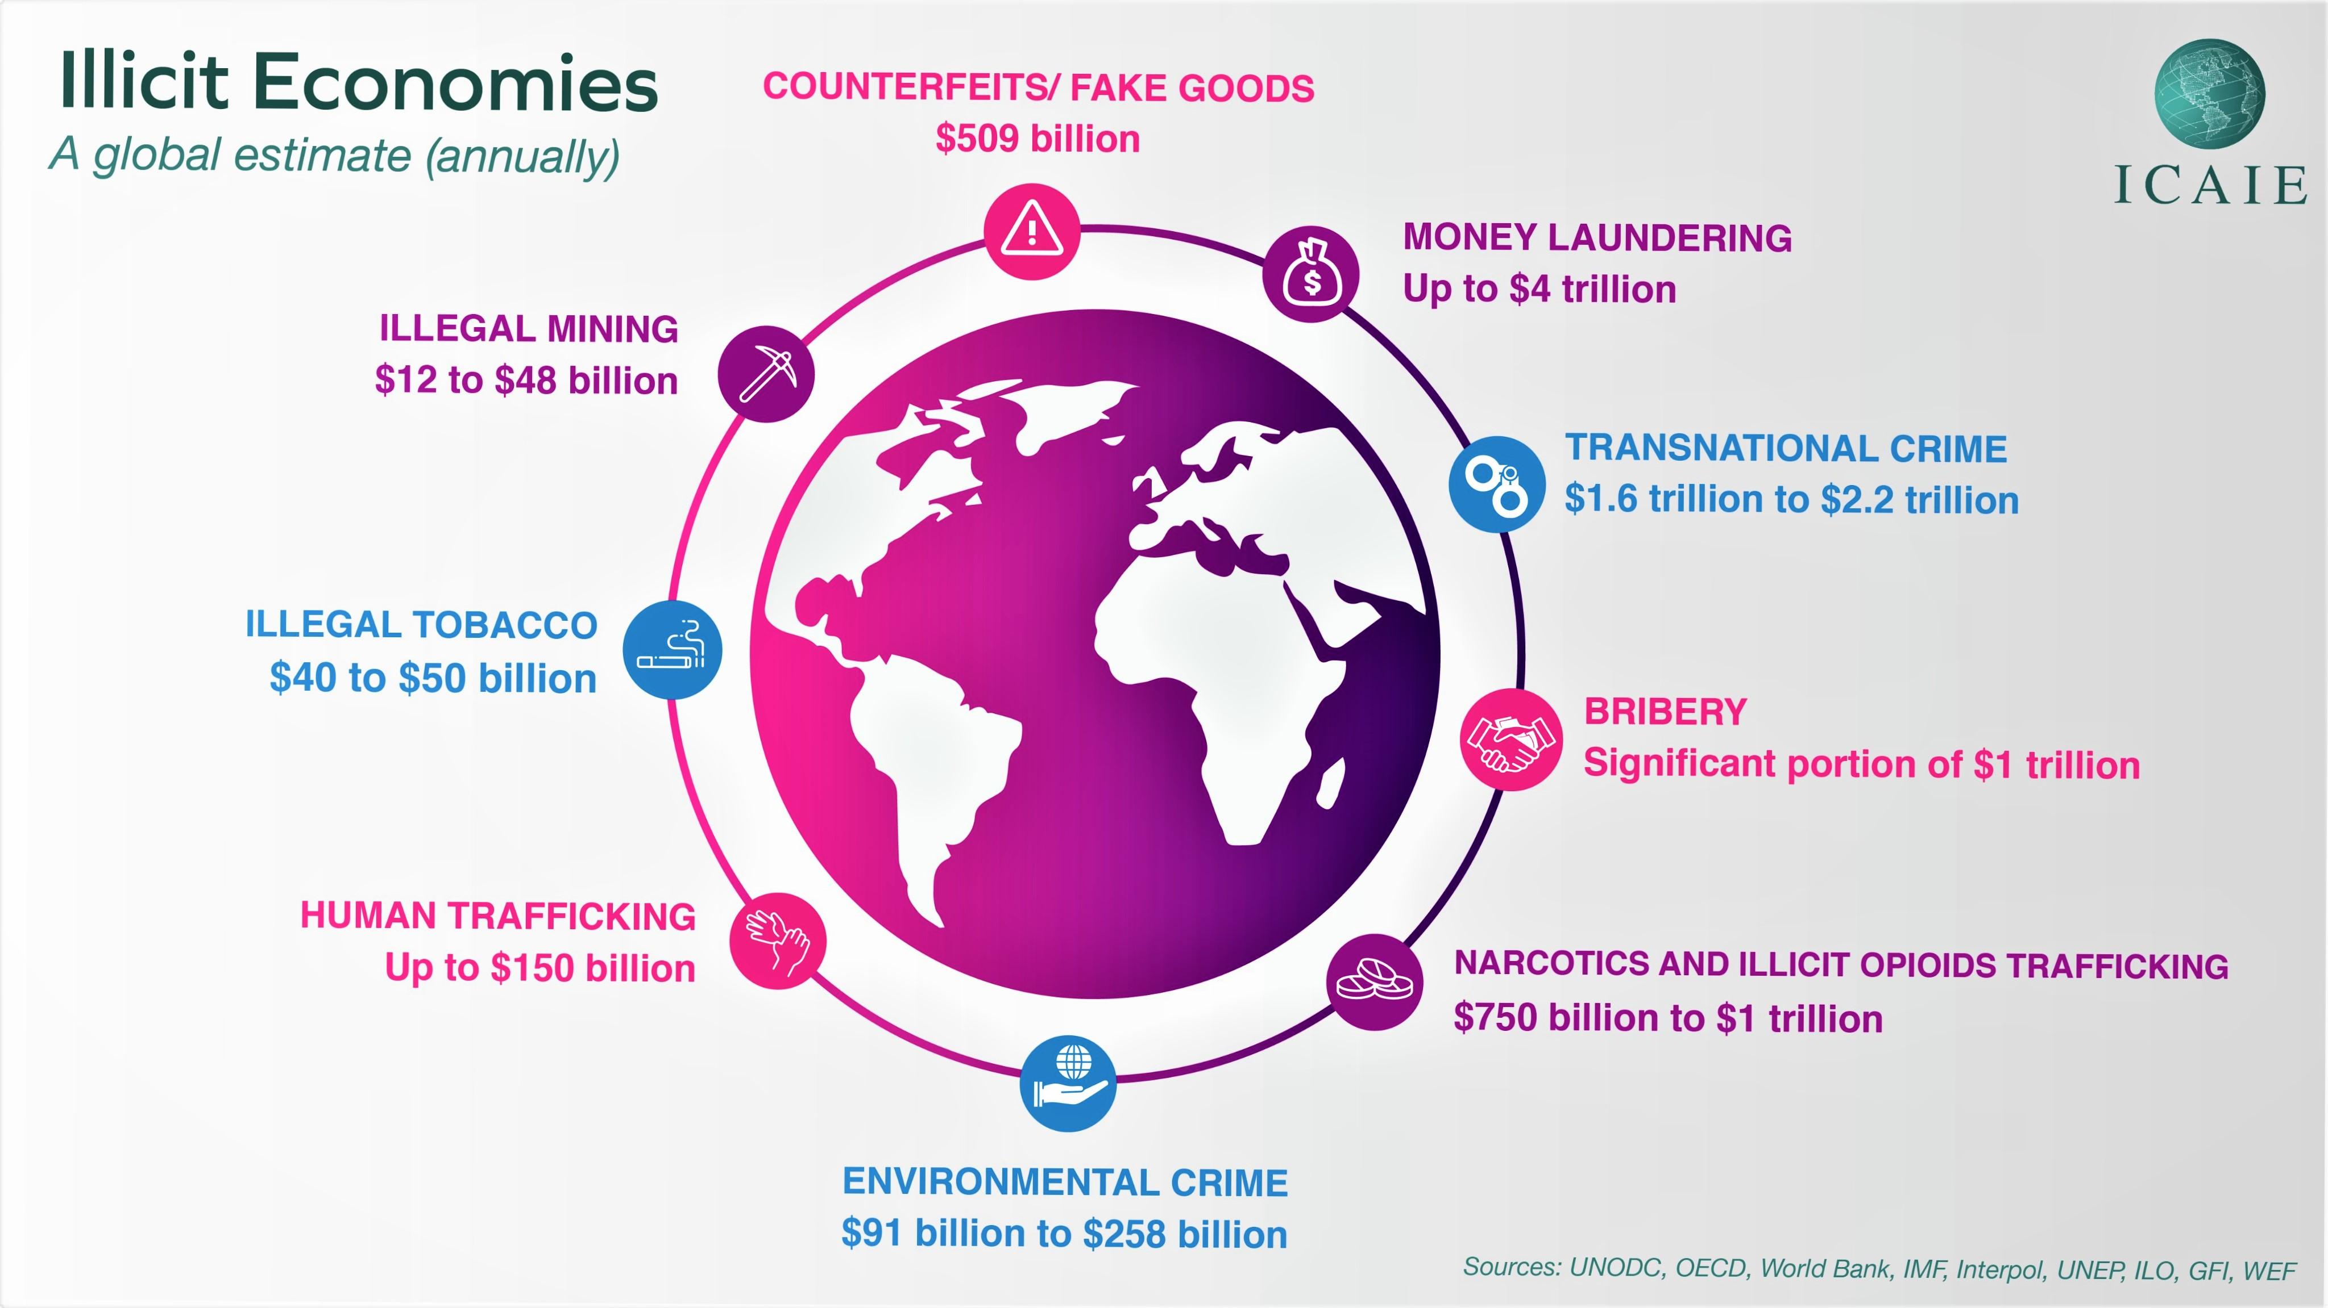

Slide 4
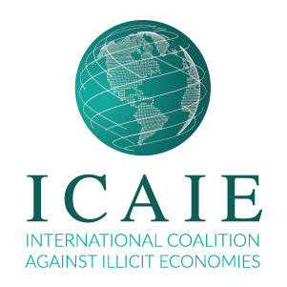
Disrupting Illicit Pathways and ML Threats Across Ports and FTZs
Hamburg
Rotterdam
Vancouver
Antwerp
Port of St. Peterburg
Busan
Isle of Man/Felixstowe
Novorossiysk
Los Angeles/L.Beach
Le Havre/Marseille
Geneva Freeport
Tokyo
Mexico
Spain Valencia, Algeciras, Barcelona
Port of Genoa; Port of Gioia Tauro
China
New York
Shenzhen, Tianjin,
Guangzhou, Ningbo,
Shanghai/Pudong
Xiamen/Fujian SEZ
Lazaro Cardenas, Manzanillo, Altamira, Veracruz
Port of Tripoli
Port of Beirut
Port Said
Jeddah
Hong Kong
Belize
Laos
Corazal Free Zone
Curaçao
Venezuela
Isla Margarita
Djibouti
DIFTZ
Boten
Panama
UAE/Dubai
Colón FZ
Jebel Ali FZ
Singapore
Colombia
Lagos
Mombasa
Malaysia
Port Kelang
Port of Tanjung Pelepas
Zona Franca de Bogotá
Maicao Special
Customs Regime Zone
Dar es Salaam
São Paulo
Australia
Brisbane Sydney,
Melbourne
Paraguay
Ciudad del Este
Tri-Border Area
Durban
Free Trade Zones are generally organized around major seaports, international airports, and national frontiers—areas with many geographic advantages for trade; shipping industry moves almost 90% of global goods.

Slide 5
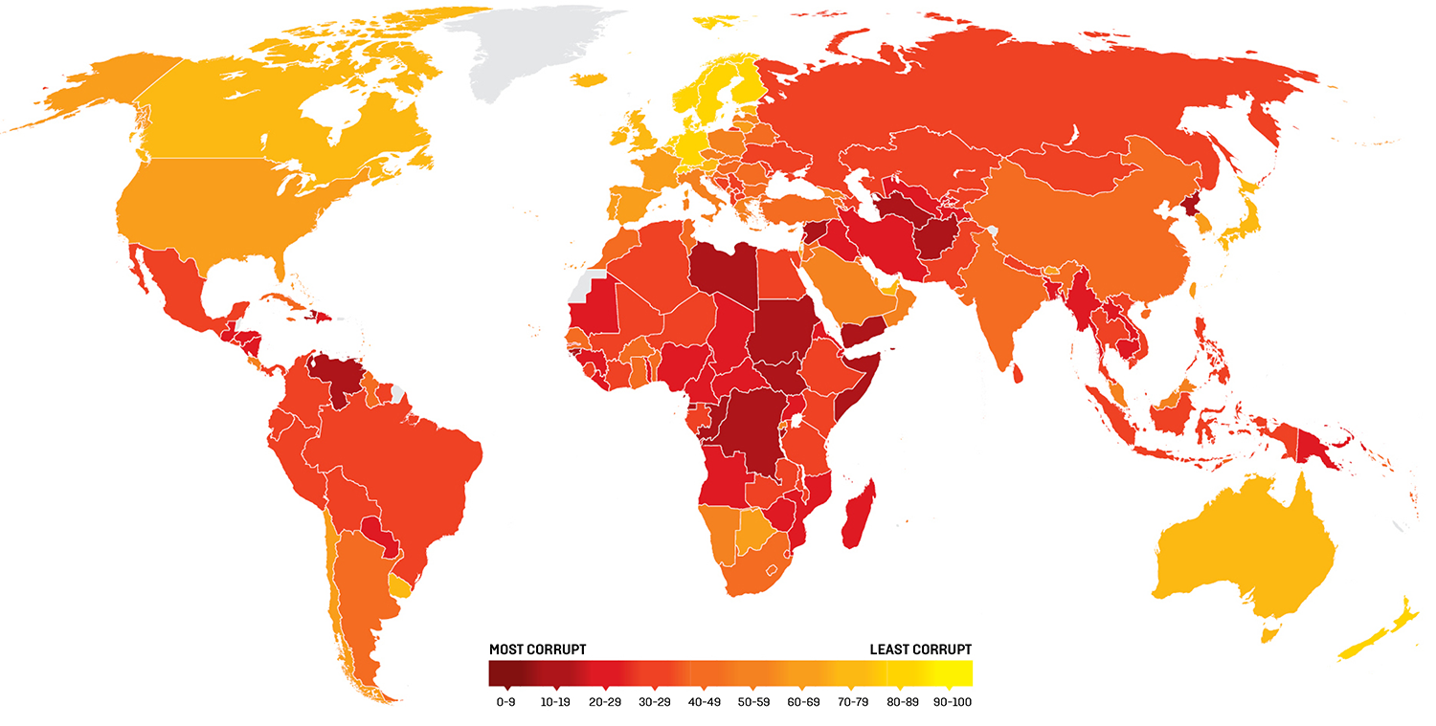

Corruption is a Threat Multiplier Across Licit-Illicit Markets

Slide 6
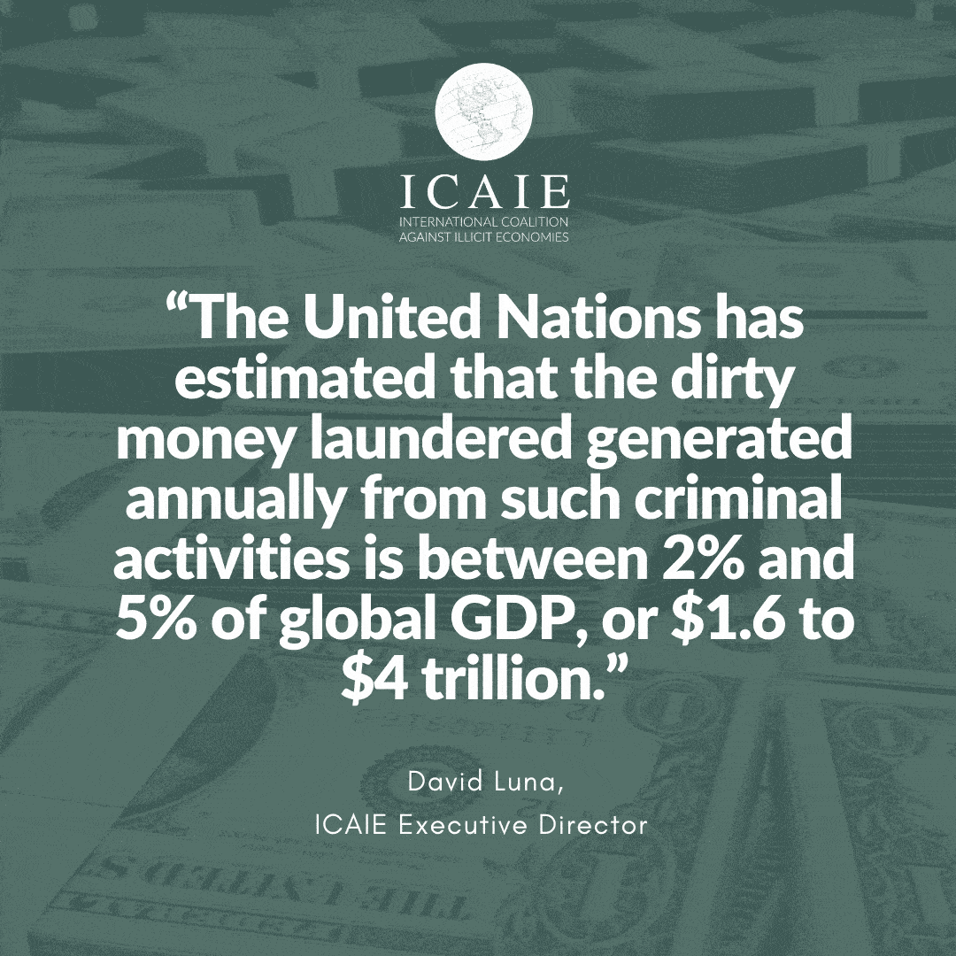
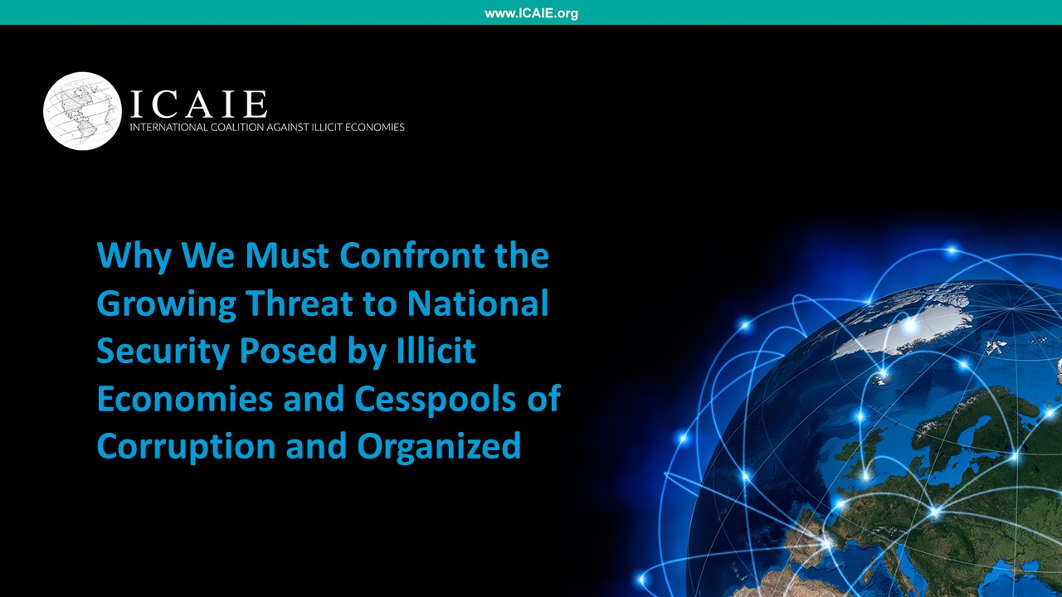
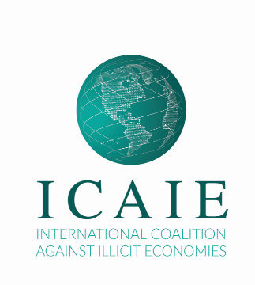
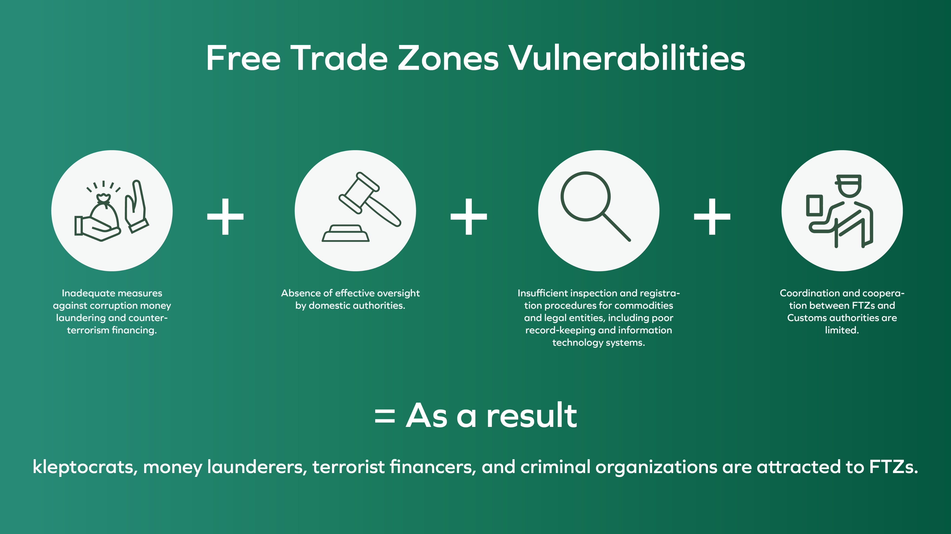

Slide 7

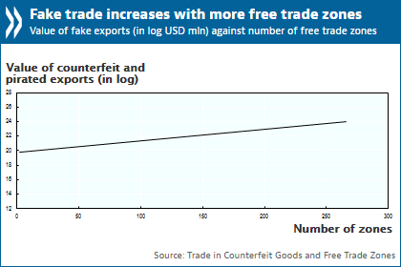
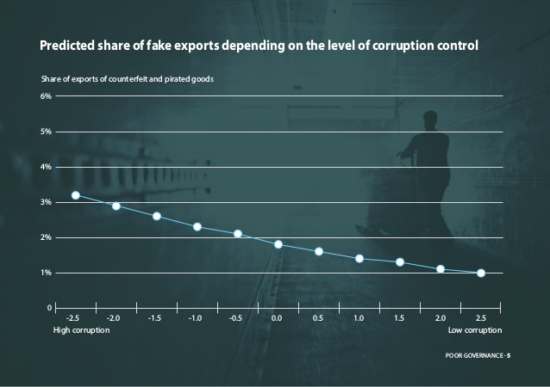
Free Trade Zones are key drivers of trade in counterfeit and pirated goods, especially with economies with weak governance.
OECD Recommendation of the Council on Countering Illicit Trade: Enhancing Transparency in Free Trade Zones
OECD Code of Conduct for Clean Free Trade Zones [Adopted on: 20/10/2019]
OECD TFCIT; Mechanism (Diagnostic Tool); Monitor Implementation

Slide 8
Countering Risky & Unruly “Illicit Spaces” Across FTZs
Regulatory Transparency /Governance Gaps
Monitor regulatory/governance gaps and lax oversight; dissuade counterfeiting, criminal practices, and disguising of fakes’ illegal origin while in transit, trans-shipment, manufacturing, re-packing, re-labeling, re-exporting in FTZs; disrupt illegal trade, smuggling, and trafficking across FTZs. Implement and enforce laws; OECD Recommendation (Enhancing Transparency in FTZs; OECD Code of Conduct; WCO SAFE / WTO TFA.
Impacts of Converging
OC Threats in Illicit Spaces
.
.
.
.
.
Illicit Trade/Illicit Economies
Understanding harmful effects of illicit economies; collecting evidence of illicit trade; information-sharing across sectors; conduct joint and cross-border investigations and support calls for prosecution.
Countering Fakes:
Regulatory/
Governance Gaps
6
Money Laundering/TBML
5
Shutting Down Money Laundering Vulnerabilities
Identify ML/Threat Finance systemic weaknesses and vulnerabilities; invest in capabilities for detecting trade-based money laundering (TBML), and red flags in accordance with FATF guidelines
Anonymous Shell Companies
4
Beneficial Ownership/Anonymity
End the abuse of anonymous shell companies, in which kleptocrats, criminals, and terrorists have avoided detection. laundered dirty money, and financed other threats, operations, and illicit empires.
Bribery/Corruption
3
Risk Assessment/ Compliance
Technologies
Make Corruption/Bribery a Priority
2
The reality is that both corruption and illicit trade are threat multipliers in FTZs that ripple across borders and imperil democratic transparency and institutions and systems vital for open, free, and just markets/societies.
Effective Controls/Compliance/Enforcement
1
Invest in Anti-Illicit Trade Prevention,
Risk Management, and Enforcement Strategies, Full Spectrum Solutions and Technologies including Blockchain, AI/Federated Learning.

Slide 9


GORDIAN BLUEPRINT
Solving the perceived complex challenges
Surfacing Criminal Networks Across Illicit Spaces
ICAIE: Intelligence Collection, Analyzed-actionable Intelligence, Enforcement [Intel Packages]
Assessing Risk: Free Trade Zones Risk Assessment Tool/13 Risk Factors [RUSI: https://ftz-risk.rusi.org/]
Mapping/Visualizing Interconnected Threats In Ports, FTZs, Intermodal Ecosystems, Supply Chains [ICAIE Partners]
Precision Disruptions: Leveraging Databases and Common Typologies [ICAIE Partners]
Identifying Illicit Spaces: Geospatial Information Systems (GIS); Communications/Device Discovery[ICAIE Partners]
Surfacing Criminal Synaptic Nodes: Social Influence Platforms/Social Network Analysis/Media [ICAIE Partners]
Surfacing Bad Actors, Enablers, and Facilitators: TOC Network Analysis/Corruptive Influencers [ICAIE Partners]
Surfacing Illicit Routes: Intermodal/Trade Infrastructure, Distribution Systems, Supply Chains [ICAIE Partners]
Connecting the Dots: Document Forgery/e-CofOrigins/TBML/Valuations/Misinvoicing/Bills of Lading [GFI/Sayari]
Pinpointing Dirty Money/Financial Safe Havens: FININT/Digital Forensics/Financial Investigations [ICAIE Partners]
Full Spectrum Technologies: AI/Federated Machine Learning/Risk Management Solutions [Consilient/SAS]
ICAIE Informational-Sharing DOLFIN Pod [K2 Integrity]: Strengthening Trust, Prevention and Enforcement [ICAIE]
ICAIE Gordian BluePrint: Actionable Intelligence; Disrupt Illicit Networks, Recoup Lost Market Value; PILOT CASES

Slide 10
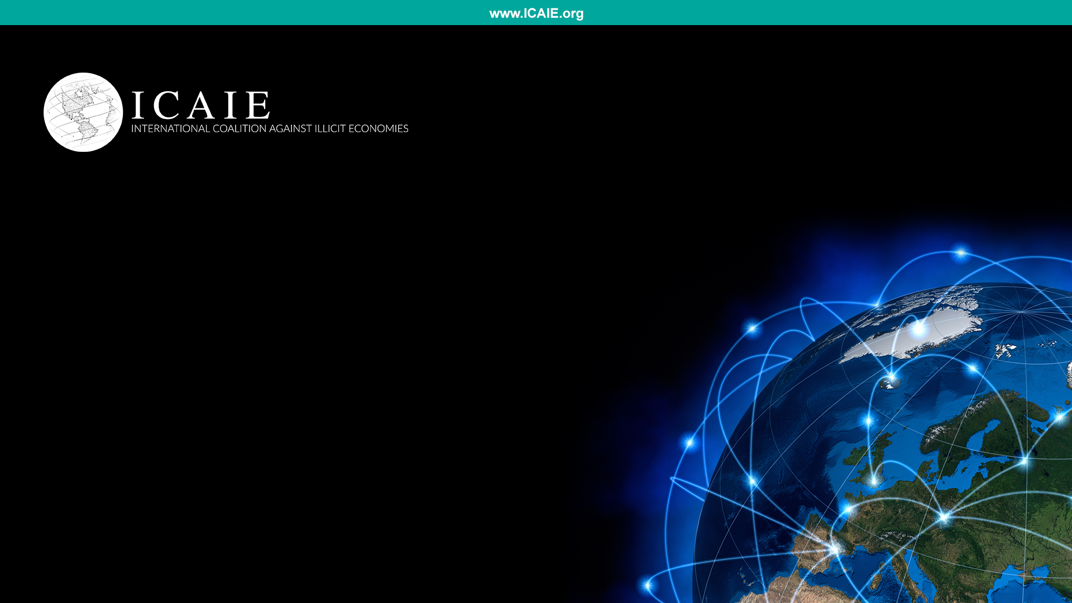
CONTACTS:
David M. Luna
Executive Director
DavidLuna@ICAIE.com
Josh Potter
Deputy Executive Director
JoshuaPotter@ICAIE.com

